Slide 1

THE BCFN YOUTH MANIFESTO
Wasting food is wasting money: the economic value of sustainability
Monica Rivelli
Parma, September 21-22
Milan, September 23

Slide 2

https://www.youtube.com/watch?v=VGTPKKOVoz4

Slide 3
Do you know that…

Slide 4

… in Italy wasting food costs the average family with children € 338 a year?
Wasted food in Italy = 5,5 million tonnes

Slide 5

… in the UK wasting food costs the average family with children £680 a year?
Wasted food in the UK = 7,2 million tonnes

Slide 6

… all over the world wasting food costs 800-1,000 billion dollars a year?
Wasted food alla over the world = 1,3 billion tonnes

Slide 7
The great paradox
Every year1/3 of the annual food production ends up in the trash, enough to feed 4 times more than 830 million starving people, 12% of world population

Slide 8





Food losses and food waste
Agricultural production
510 million tonnes wasted = 32%
Post-harvesting and storage
355 million tonnes wasted = 22%
Industrial processing
180 million tonnes wasted = 11%
Distribution
200 million tonnes wasted = 13%
Household and restaurant industries
345 million tonnes wasted = 22%
FAO, 2013

Slide 9
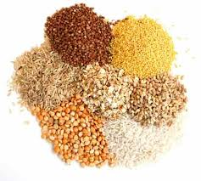
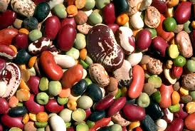




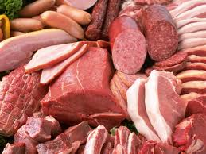
What we waste and how much
30%
45%
30%
20%
20%
20%
45%
FAO, 2013

Slide 10
Food wastage footprint
Water: the quantity of water required to produce the food that is wasted each year in the world is about 250,000 billion liters. It is more or less the quantity to meet the domestic consumption of water of a city like New York for the next 120 years
Soil: the extension of agricultural soil necessary to produce the food wasted each year in the world is about 1.4 billion hectares, approximately 30% of the agricultural area available at the global level
Climate change: the food wasted each year in the world is responsible for entering into the atmosphere of about 3.3 billion tonnes of CO2 equivalent (CO2eq). If the waste food were a country, it would be the third producer in the world after the US and China.
FAO, 2013

Slide 11
Costs Accounting
1,000 billions dollars/year
(wasted food costs)
700 billions dollars/year
(environmental costs)
900 billion dollars/year
(social costs)
+
+
Some examples:
Climate changes – 394 billion dollars/year
Water scarcity, specially in arid regions of the world – 164 billion dollars/year
Loss of soil nutrients and reduction of crop yields - 35 bilion dollars/year
Impacts caused by the use of pesticides in agriculture, the loss of the ability of pollination insects , overfishing – 32 billion dollars/year
Some examples:
Conflicts related to scarcity of resources, with particular reference to the agricultural soil – 396 billion dollars/year
Loss of self-sustenance ability caused, in the first place, by soil erosion – 333 billion dollars/year
The adverse effects on human health due to pesticides used in agriculture – 153 billion dollars/year
FAO, 2013

Slide 12
Households wasting food
In Italy wasting food costs the average family with children € 6,5 per week.
Most food thrown away by households could have been eaten.

Slide 13
Why does food go to waste?
Cooking and preparing too much
Not using up food in time
Not eating food before its use-by date.

Slide 14
What foods are we most likely to waste?
The top five:
fresh fruit
meat and fish
bread and bakery products
dairy produce
rice and pasta

Slide 15
How can we prevent food waste and save money?
Pre-plan meals to avoid unnecessary buying
Always write a shopping list
Perfect portions - only cook what you need
Store and freeze leftovers
Use up leftovers

Slide 16
Think about it!
Tell your solutions
The value of food
The value of sustainability
The value of money
Journalist
NGO Activist
Educator
Policy Maker
Researcher
Farmer
Food Industry
Food is no more a value. We do not give value to food that is why we waste 1,000 billions dollars/year. Wasting food is wasting money.
How can we prevent food waste and save money?
What you will do if you were

Slide 17
Thank you
m.rivelli@feduf.it

